Slide 1
Model robustness and regularization
Enhancing Generalization in Machine Learning
Nengfeng Zhou, Wells Fargo
10/16/2023
Disclaim: The views expressed in the presentation are those of the author and do not represent the views of Wells Fargo

Slide 2
Agenda
Bias and Variance
Overfitting
Techniques to Mitigate Overfitting
Model Robustness to Data Perturbation
Case Studies
Q&A

Slide 3
Bias and Variance

Slide 4
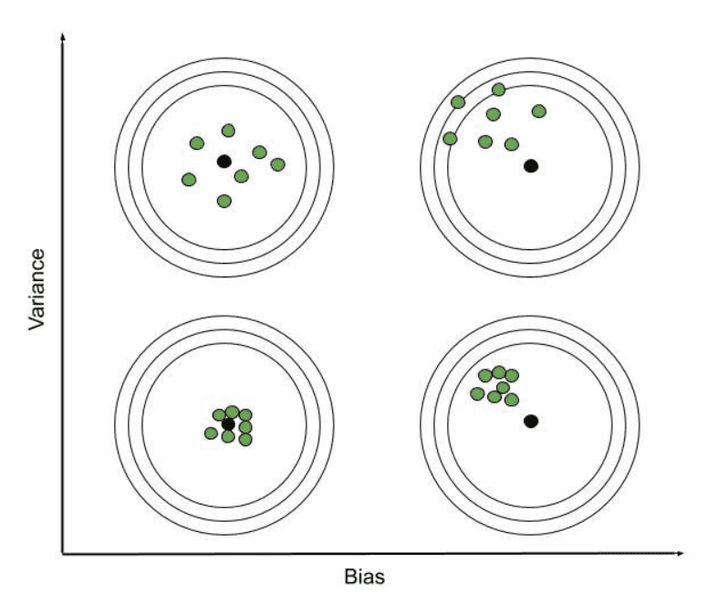
Bias and Variance
Bias: Error due to overly simplistic assumptions in the learning algorithm. High bias can cause the model to miss relevant relations between features and target outputs.
Variance: Error due to too much complexity in the learning algorithm. High variance can cause the model to model the random noise in the training data.

Slide 5
Bias and Variance
High Bias
Simplistic models that may not capture complex relationships.
Underfitting: Fails to capture underlying patterns in data.
Mitigation: Increase model complexity, use more advanced algorithms.
High Variance
Complex models that may fit to noise in the data.
Overfitting: Models noise as if it were a pattern.
Mitigation: Use simpler models, add more training data, apply regularization techniques.

Slide 6
Impact on Model Performance
Low Bias, Low Variance:
Model generalizes well on both training and testing data.
High Bias, Low Variance:
Model underfits, performs poorly on both training and testing data.
Low Bias, High Variance:
Model overfits, performs well on training but poorly on testing data.
High Bias, High Variance:
Rare, but when it occurs, model performs poorly on all data.

Slide 7
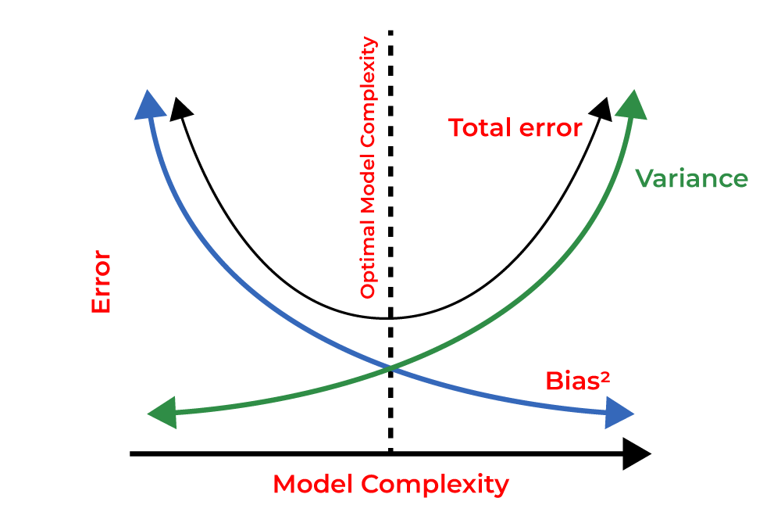
Bias-Variance Tradeoff
Achieving
Achieving low bias and low variance simultaneously is challenging. There's a tradeoff between bias and variance.
Balancing
Balancing bias and variance is crucial for building models that generalize well.

Slide 8
Overfitting

Slide 9
Causes of Overfitting
Complex Models
Models with high capacity can fit the training data too closely, capturing noise and spurious correlations.
Insufficient Data
When there's not enough data relative to the complexity of the model, it's easy to fit noise.
Noisy Data
Data with inherent randomness or errors can be mistakenly treated as signal.

Slide 10
Consequences of Overfitting
Poor Generalization
Overfit models fail to generalize patterns beyond the training set.
Reduced Predictive Power
Performance on unseen data deteriorates significantly.
Limited Real-world Applicability
Overfit models often fail when faced with new, real-world data.

Slide 11
Metrics to Measure Overfitting
ROC-AUC Score (for Binary Classification):
Receiver Operating Characteristic - Area Under the Curve measures the area under the ROC curve. AUC close to 1 indicates a good model, but if it's significantly higher on the training data than the test data, overfitting might be present.
R-squared (for Regression):
In regression problems, R-squared measures how well the model's predictions match the actual data. If R-squared is very high on training data but much lower on test data, overfitting may be occurring.

Slide 12
Techniques to Mitigate Overfitting

Slide 13
Techniques to Mitigate Overfitting
Model Simplification
Reducing Model Complexity : Use simpler models with fewer parameters to avoid fitting noise.
Feature Selection : Identify and utilize only the most relevant features, discarding less informative ones.
Regularization
L1 and L2 Regularization : Add penalty terms to the loss function to discourage large weights, preventing the model from becoming too complex.
Dropout : Randomly deactivate neurons during training to prevent over-reliance on specific neurons.
Early Stopping : Monitor validation performance and stop training once performance on a separate validation set plateaus or starts to worsen.
Data Augmentation
Increasing Training Data : Collecting more diverse and representative data to reduce the likelihood of overfitting.
Cross-Validation :Use techniques like k-fold cross-validation to assess how well the model will generalize to new data.

Slide 14
Model Simplification
Reducing Model Complexity : Use simpler models with fewer parameters to avoid fitting noise. For example, in XGBoost model, model simplicity can be achieved by:
Limiting the Maximum Depth of Trees (max_depth)
Minimizing the Number of Trees (n_estimators)
Increasing Minimum Child Weight (min_child_weight)
Reducing the Learning Rate (learning_rate)
Feature Selection : Identify and utilize only the most relevant features, discarding less informative ones.
For example, in XGBoost model, analyze feature importance scores after training and consider removing less important features. This simplifies the model and may improve performance.

Slide 15
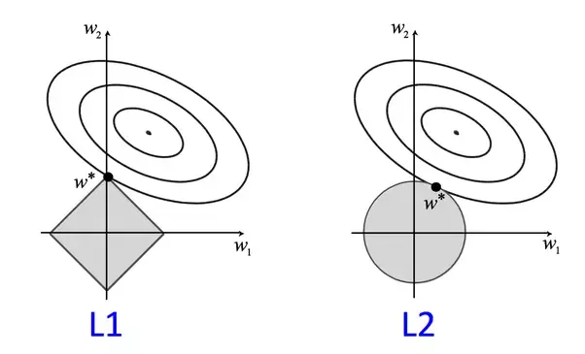
L1 and L2 Regularization
L1 Regularization
L2 Regularization
Concept:
Advantages:
Provides a sparse solution (some coefficients are exactly zero), making it easier to interpret the model.
Disadvantages:
It may not perform well if all features are important or if features are highly correlated.
L1 regularization, also known as Lasso (Least Absolute Shrinkage and Selection Operator), adds the absolute values of the coefficients (also known as weights) to the loss function.
Can be used for feature selection.
Concept:
Advantages:
Helps prevent multicollinearity (correlation between predictor variables).
Disadvantages:
Doesn't perform feature selection as effectively as L1 regularization.
Generally performs well when all features are relevant.
L2 regularization, also known as Ridge, adds the squares of the coefficients to the loss function.
In XGBoost model, the reg_alpha and reg_lambda parameters introduce L1 and L2 regularization terms, respectively, to the model's objective function. The default value of 0 means no L1/L2 regularization.

Slide 16
Dropout
Definition:
Dropout is a technique in which randomly selected neurons in a neural network are temporarily deactivated (or "dropped out") during training. This means that these neurons do not contribute to the forward pass of information or the backward pass of gradients during a particular training iteration.
How Dropout Works:
During each training iteration, a random subset of neurons is "dropped out" with a certain probability (typically around 0.5). This means that for that iteration, those neurons do not participate in the computation of the output.
In the next iteration, a different random subset of neurons is dropped out.
This process of randomly dropping out neurons is repeated for each training iteration.
Effect of Dropout:
Dropout introduces a form of redundancy in the network. Because different subsets of neurons are dropped out in each iteration, the network is forced to learn more robust and generalized features. It prevents the network from relying too heavily on any particular set of neurons.

Slide 17
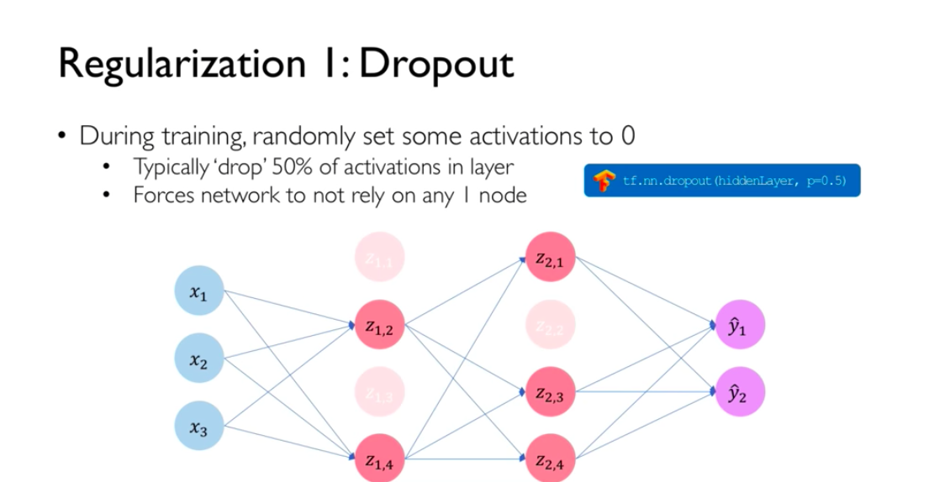
Dropout

Slide 18
Early Stopping
Early stopping is a regularization technique used in training machine learning models, particularly in deep learning. It involves monitoring the performance of the model on a validation dataset during training and stopping the training process once the performance on the validation set starts to deteriorate.
Monitoring Validation Performance: During the training process, a separate validation dataset (not used for training) is set aside to evaluate the model's performance.
Tracking Loss or Metric: The performance of the model is assessed based on a chosen metric (e.g., loss function, accuracy, etc.) calculated on the validation set.
Early Stopping Criterion: An early stopping criterion is defined, such as "stop training if the validation loss does not improve for a certain number of epochs."
Stopping Criteria: The stopping criteria can be based on various conditions, like a specific number of epochs without improvement, or when the improvement falls below a certain threshold.
Halting Training: Once the stopping criteria are met, the training process is halted, and the model parameters at that point are considered the final model.

Slide 19
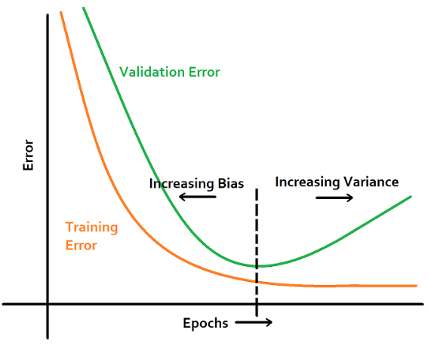
Early Stopping
Example python code:
eval_set = [(X_val, y_val)]
xgb_model.fit(X_train, y_train, eval_set=eval_set, eval_metric='rmse', early_stopping_rounds=10)

Slide 20
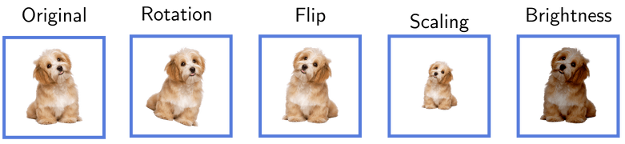
Data Augmentation
Data Augmentation is a technique used in machine learning and deep learning to increase the diversity of a training dataset without collecting additional data. It involves applying various transformations to the existing data, such as rotations, translations, flips, zooms, and changes in brightness or contrast.
Increased Robustness to Variations
Reduced Overfitting
Improved Generalization
Smoothed Decision Boundaries
Enhanced Model Performance
Savings on Data Collection
Addressing Class Imbalance
Adaptability to Different Domains

Slide 21
Cross-Validation
Cross-validation is a technique used in machine learning to assess the performance of a model and to mitigate problems related to overfitting or data variability. It involves splitting the available dataset into multiple subsets or "folds" and training, validating, and testing the model on different combinations of these subsets.
Process of Cross-Validation:
Step 1: Data Splitting
The dataset is divided into k subsets of approximately equal size. These are often referred to as "folds."
Step 2: Model Training and Evaluation
The model is trained and evaluated multiple times, each time using a different combination of training and validation sets. Specifically, the following steps are performed for each fold:
The model is trained on k-1 folds (the training set).
The model's performance is evaluated on the remaining fold (the validation set).
Step 3: Performance Aggregation
The performance metrics obtained from each fold are aggregated to provide an overall assessment of the model's performance.
Optional Step: Model Selection or Hyperparameter Tuning
Cross-validation can be used to compare different models or to tune hyperparameters. Each combination of model and hyperparameters is evaluated using the cross-validation process.

Slide 22
Model Robustness

Slide 23
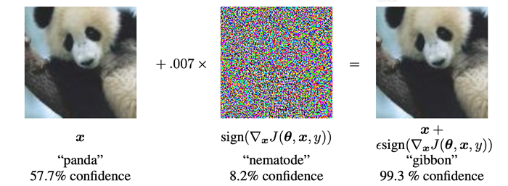
Model Robustness
Model robustness refers to the ability of a machine learning model to maintain its performance and make accurate predictions even when it encounters data points or scenarios that differ from those in the training data. In other words, a robust model is able to handle variations, noise, outliers, or changes in the input without a significant drop in performance.
https://pyimagesearch.com/2020/10/19/adversarial-images-and-attacks-with-keras-and-tensorflow/

Slide 24
Importance of Model Robustness
Generalization to Unseen Data: Robust models are better at generalizing to new, unseen data. They are less likely to be misled by noisy or unexpected inputs.
Real-world Applicability: In practical applications, data may vary over time or across different contexts. A robust model is better equipped to handle these variations.
Resilience to Outliers: Robust models are less sensitive to outliers or erroneous data points, making them more reliable in scenarios where data quality may not be perfect.
Defending Against Adversarial Attacks: In security-critical applications like cybersecurity or fraud detection, robust models are crucial in withstanding deliberate attempts to manipulate or deceive the model.
Reduced Overfitting: A robust model is less likely to overfit to the training data, as it focuses on learning generalizable patterns rather than memorizing specific examples.

Slide 25
Testing model robustness
Testing model robustness involves evaluating how well a machine learning model performs under various conditions, including scenarios it may not have encountered during training. Here are some methods to test model robustness:
Out-of-Distribution Testing: Evaluate the model on data from a different distribution than the one it was trained on. This helps assess how well the model generalizes to unseen variations.
Adversarial Testing: Generate or obtain adversarial examples, which are intentionally crafted inputs designed to mislead the model. Test the model's performance on these adversarial samples.
Noisy Data Testing: Add random noise to the test data and evaluate how the model handles noisy inputs. This tests the model's robustness to variations in the input.
Concept Drift Testing: Simulate or obtain data that reflects changes in the underlying distribution over time. Test the model's performance on this data to evaluate its adaptability to dynamic environments.

Slide 26


Metrics for robustness (ArPPV)
Average root Perturbed Prediction Variance (ArPPV):
For each observation x_{i}, perturb x_{i} K times in a local neighborhood LN(b), where b is a measure of locality. As b increases, the perturbations are larger and for b = 0, we do not perturb the observations. Δx_{ik} is the kth perturbation on observation x_{i}.
Calculate $\hat{y}$_{ik} = Model(x_{i} + Δx_{ik} ). We also have $\hat{y}$_{i} and y as the original prediction and true response respectively. In case of binary response, the prediction might be in probability scale or log-odds scale.
Summarize the variability in $\hat{y}$_{ik} as a measure of robustness. We can use different metrics in order to summarize this variability.
$$ArPPV : \sqrt{\frac{1}{K}\sum_{k}{{({\hat{y}}_{ik}−{\hat{y}}_{i})}^{2}}}$$

Slide 27

Metrics for robustness (Performance based)
Performance based robustness metrics: assesses model performance to small changes in the covariate space. It proceeds as follows,
Perturb x with changes Δx.
Calculate the model’s output $\hat{f}$(x+ Δx ) on perturbed data.
Evaluate the performance metric of Score(y, $\hat{f}$(x+ Δx ) ).
This process is iterated ten times for all the test samples, with performance metrics recorded for each repetition.
It is important to note that the assumption is made that the response remains unchanged throughout. Perturbation can be applied to both numerical and categorical features. The forthcoming sections will illustrate the perturbation methods for numerical and categorical features, respectively.

Slide 28
Perturbation methods in robustness test
Raw perturbation: Directly add i.i.d. Gaussian noise N(0, λ²var(x)) to x, where
λ is the perturbation size. However, this method may not be suitable when
The data is discrete, e.g., 1, 2, 3, … 10. In this case, the perturbed data, e.g., 1.2 may become invalid.
The data is skewed and has a long tail distribution. In this case, the calculation of standard deviation may become unstable, and it is relatively hard to choose a suitable perturbation size.
The data has special values, such as 999999999.

Slide 29

Perturbation methods in robustness test
Quantile Perturbation: Quantile perturbation can solve the above issues.
First, the feature is converted to the quantile space.
The uniform noise is then added to perturb the quantiles. Here also represents the perturbation size.
Finally, transform the quantiles to the original space.
Let’s take into account a data point with a value of 3, along with its corresponding quantile value of 0.7. On the quantile scale, a small noise of 0.12 is generated and added to the original quantile value of 0.7. This sum yields a resulting value of 0.82, which is then rounded to the nearest available value, namely 0.8. Finally, the perturbed quantile is transformed back to the original scale, resulting in a value of 40.

Slide 30
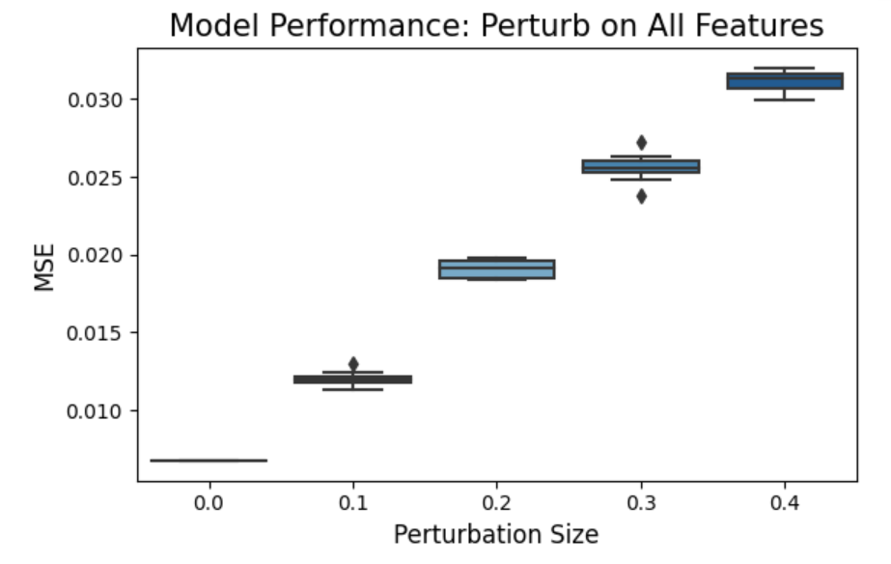
Example of robustness (Performance based)

Slide 31
Case Studies

Slide 32
PiML Toolbox
https://github.com/SelfExplainML/PiML-Toolbox
Accuracy: popular metrics like MSE, MAE for regression tasks and ACC, AUC, Recall, Precision, F1-score for binary classification tasks.
Explainability: post-hoc global explainers (PFI, PDP, ALE) and local explainers (LIME, SHAP).
Fairness: disparity test and segmented analysis by integrating the solas-ai package.
WeakSpot: identification of weak regions with high residuals by slicing techniques.
Overfit: identification of overfitting regions according to train-test performance gap.
Reliability: assessment of prediction uncertainty by split conformal prediction techniques.
Robustness: evaluation of performance degradation under covariate noise perturbation.
Resilience: evaluation of performance degradation under different out-of-distribution scenarios.

Slide 33
PiML Toolbox: Load data
Taiwai Credit data (30000 x 24):
https://colab.research.google.com/drive/1jVVDesIAX4BYZo6gAzhuKmn7hEpDDWtb?usp=sharing
!pip install piml
from piml import Experiment
exp = Experiment()
# Choose TaiwanCredit
exp.data_loader()
exp.data_summary()
 | Name | n_missing | mean | std | min | q1 | median | q3 | max
0 | LIMIT_BAL | 0.0 | 167484.3227 | 129747.6616 | 10000.0 | 50000.0 | 140000.0 | 240000.0 | 1000000.0
1 | AGE | 0.0 | 35.4855 | 9.2179 | 21.0 | 28.0 | 34.0 | 41.0 | 79.0
2 | PAY_1 | 0.0 | 0.1672 | 0.9313 | -1.0 | 0.0 | 0.0 | 0.0 | 8.0
3 | PAY_2 | 0.0 | 0.1184 | 0.9658 | -1.0 | 0.0 | 0.0 | 0.0 | 8.0
4 | PAY_3 | 0.0 | 0.1061 | 0.9509 | -1.0 | 0.0 | 0.0 | 0.0 | 8.0
5 | PAY_4 | 0.0 | 0.0692 | 0.9116 | -1.0 | 0.0 | 0.0 | 0.0 | 8.0
6 | PAY_5 | 0.0 | 0.0369 | 0.8646 | -1.0 | 0.0 | 0.0 | 0.0 | 8.0
7 | PAY_6 | 0.0 | 0.0352 | 0.8679 | -1.0 | 0.0 | 0.0 | 0.0 | 8.0
8 | BILL_AMT1 | 0.0 | 3.886 | 1.547 | -5.219 | 3.5514 | 4.3499 | 4.8267 | 5.9843
9 | BILL_AMT2 | 0.0 | 3.7954 | 1.6545 | -4.8437 | 3.4751 | 4.3264 | 4.8062 | 5.993
10 | BILL_AMT3 | 0.0 | 3.7394 | 1.6968 | -5.1966 | 3.4261 | 4.303 | 4.7793 | 6.2212
11 | BILL_AMT4 | 0.0 | 3.6701 | 1.7339 | -5.2305 | 3.3669 | 4.28 | 4.7365 | 5.9502
12 | BILL_AMT5 | 0.0 | 3.5993 | 1.7625 | -4.9103 | 3.2465 | 4.2578 | 4.7006 | 5.9672
13 | BILL_AMT6 | 0.0 | 3.5075 | 1.8331 | -5.531 | 3.0993 | 4.2323 | 4.692 | 5.983
14 | PAY_AMT1 | 0.0 | 2.8794 | 1.4116 | 0.0 | 3.0004 | 3.3224 | 3.6996 | 5.9413
15 | PAY_AMT2 | 0.0 | 2.8501 | 1.4239 | 0.0 | 2.9212 | 3.3032 | 3.6991 | 6.2264
16 | PAY_AMT3 | 0.0 | 2.7288 | 1.4548 | 0.0 | 2.5922 | 3.2555 | 3.6538 | 5.9523
17 | PAY_AMT4 | 0.0 | 2.6395 | 1.4751 | 0.0 | 2.4728 | 3.1764 | 3.6036 | 5.7931
18 | PAY_AMT5 | 0.0 | 2.6197 | 1.4957 | 0.0 | 2.404 | 3.1764 | 3.6056 | 5.6299
19 | PAY_AMT6 | 0.0 | 2.5766 | 1.5322 | 0.0 | 2.0746 | 3.1764 | 3.6022 | 5.7232

Slide 34
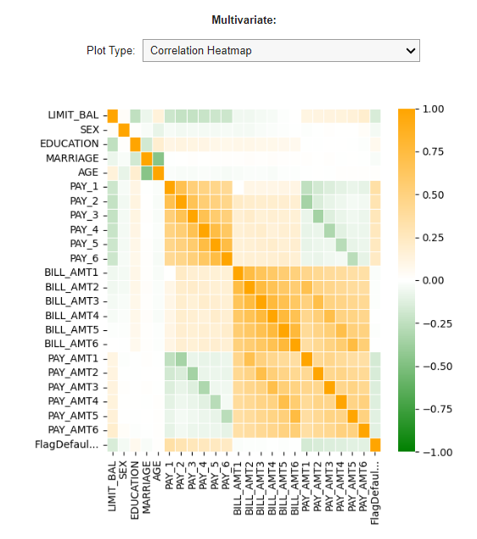
PiML Toolbox: Prepare data
Data preparation
# Prepare dataset with default settings
exp.data_prepare()
exp.eda()

Slide 35
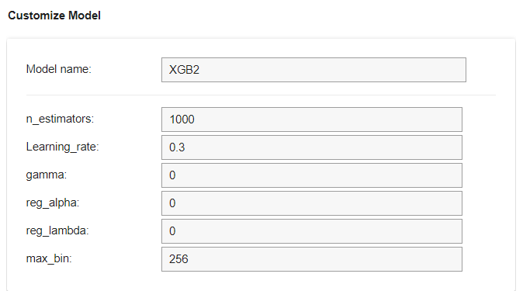
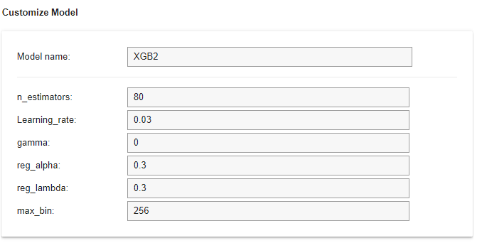
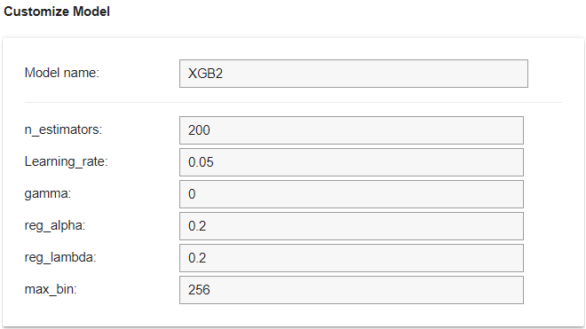
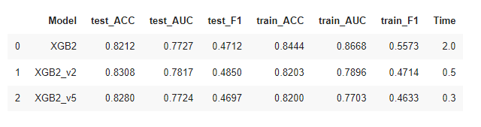
Model configuration
Train three xgboost models
Xgb2_v5: underfitting
Xgb2_v2: optimized model
Xgb2: overfitting

Slide 36
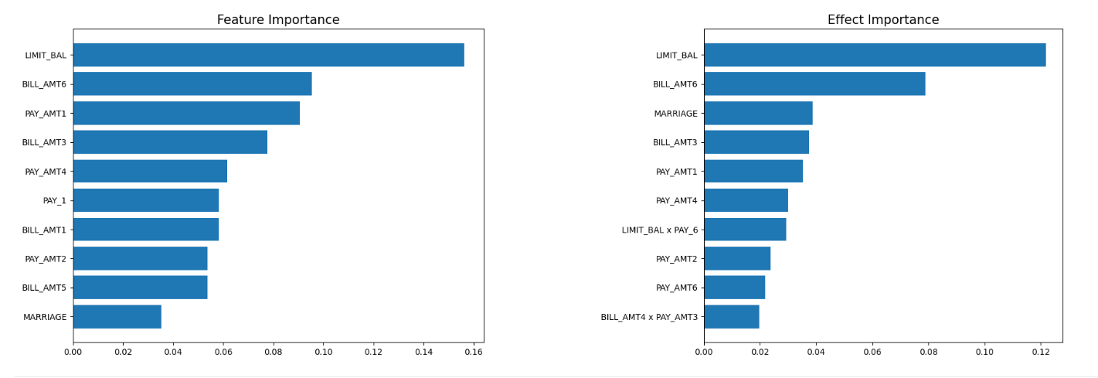
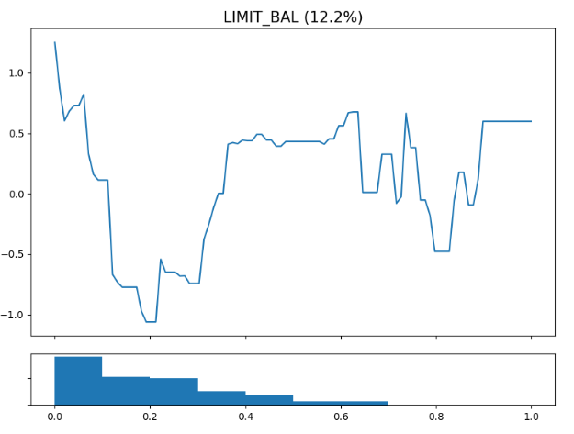
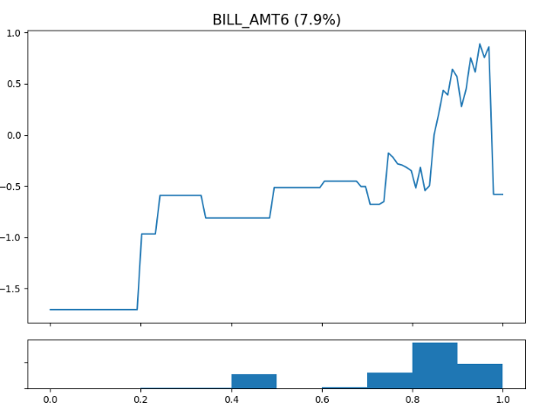
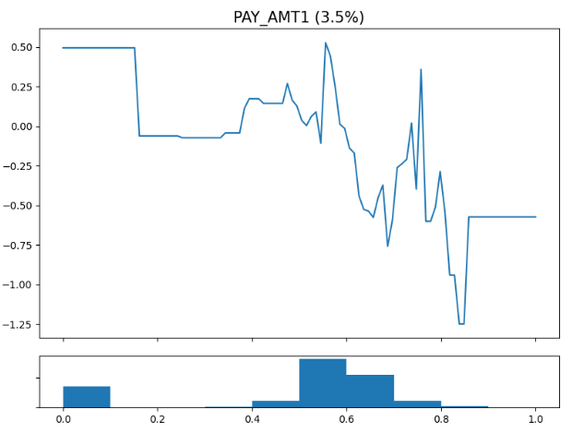
Model interpretation
XGB2 (overfitting)
exp.model_interpret()

Slide 37
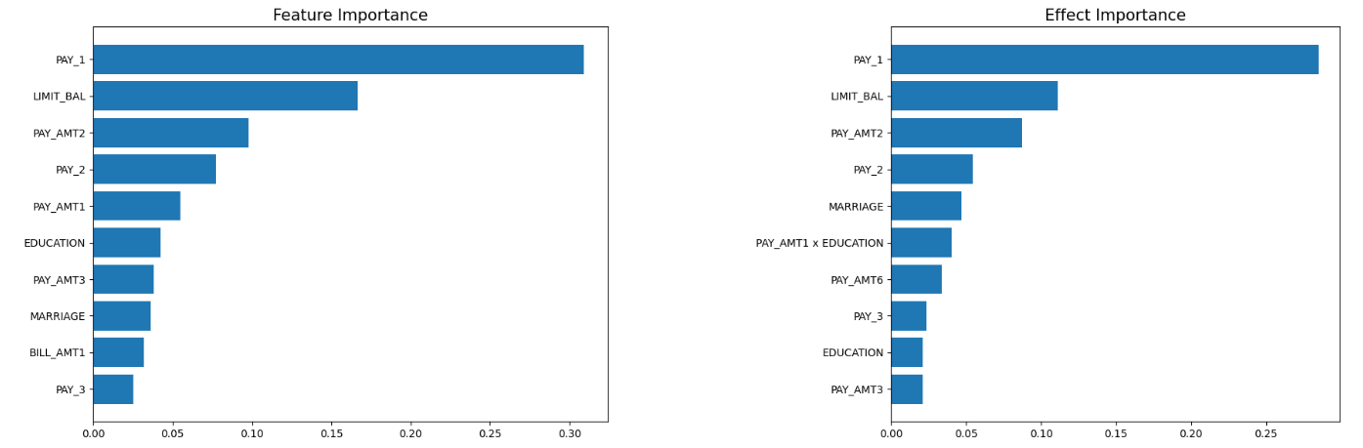
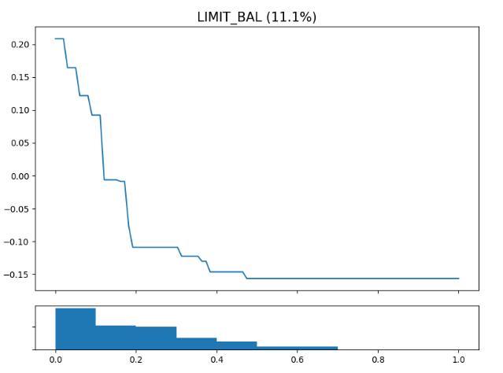
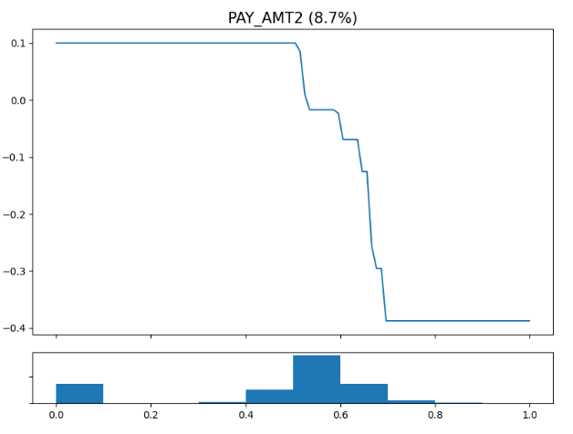
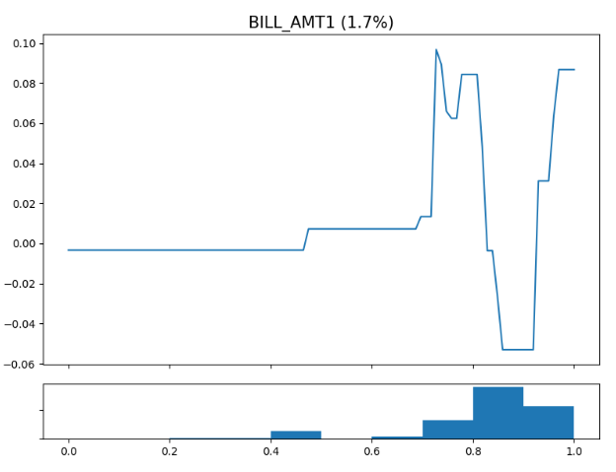
Model interpretation
XGB2_v2 (optimized model)
exp.model_interpret()

Slide 38
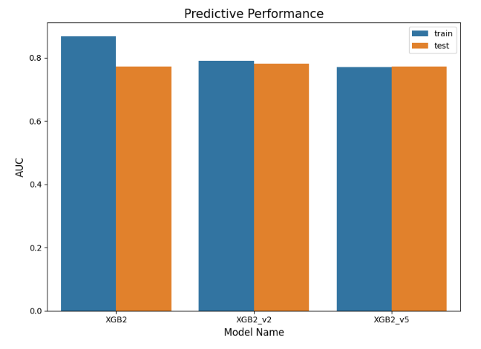
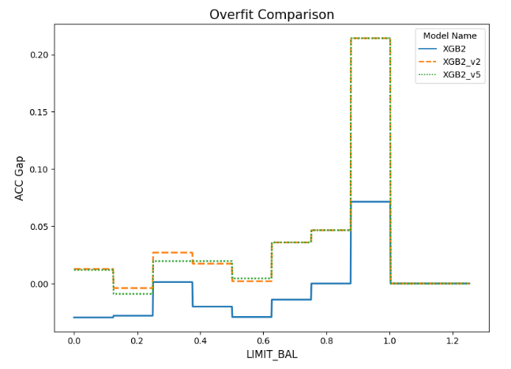
Model diagnostic for overfitting
XGB2 (overfitting model)
XGB2_v5 (underfitting model)
XGB2_v2 (optimized model)
exp.model_compare()

Slide 39
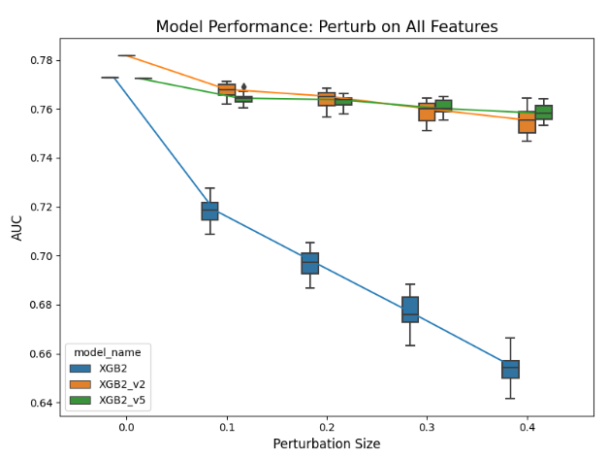
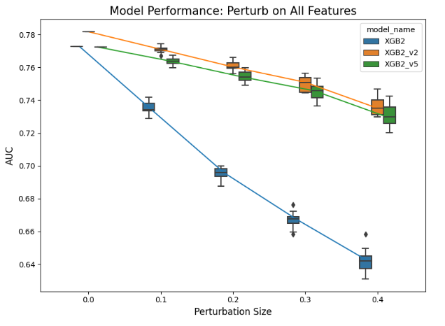
Model diagnostic for robustness
XGB2 (overfitting model)
XGB2_v5 (underfitting model)
XGB2_v2 (optimized model)
Raw perturbation
qunatile perturbation
exp.model_compare()

Slide 40
Q&A

